Slide 1
大数据分析师的卓越之道
吴甘沙
英特尔中国研究院

Slide 2
数据分析的典型场景
Data
Value
Data
Knowledge
Discovery
Value
Infrastructure

Slide 3
基础设施已经改朝换代 分析师也需要与时俱进
改变思维方式
提高技术素养
丰富分析能力

Slide 4

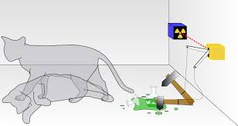
新的世界观：不确定的世界

Slide 5
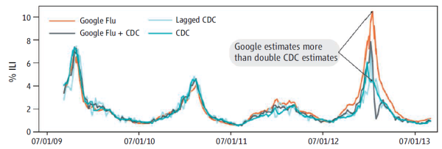
大数据的测不准
《自然》：测不准
《科学》：大数据傲慢

Slide 6
数据分析方法论的升级
Hypotheses
Collection
Preparation
Analytics
Interpretation
Evaluation
Notes:
Strategy is a logical argument for the creation and capture of value.
All arguments, and hence all strategies, rest on assumptions.
Strategy is an iterative process of testing and revising your argument as your assumptions play out in the market.

Slide 7
数据分析方法论的升级
Hypotheses
Collection
Preparation
Analytics
Interpretation
Evaluation

Slide 8
Hypotheses
机械地发掘相关性和假设
直觉，拿侦探小说练手
阅读广泛涉猎
跨界思维碰撞
融入业务部门
防止数据采集与分析、业务与数据分析的脱节

Slide 9
数据分析方法论的升级
Hypotheses
Collection
Preparation
Analytics
Interpretation
Evaluation

Slide 10
数据！数据！数据！
n=All !
Enterprise Data Warehouse → Enterprise Data Hub/Data Lake
External data sources
Structured → semi-structured → unstructured
Log analysis
Text analysis
Image/video
Data with geo and temporal tags
Networks and graphs
Notes:
Che Pingjue: wireless data
The limitation of data warehouses is that they store data from various sources in some specific static structures and categories that dictate the kind of analysis that is possible on that data, at the very point of entry.
This approach has started to fall apart in the world of big data discovery where it is very difficult to ascertain upfront all the intelligence and insights one would be able to derive from the variety of different sources, including proprietary databases, files, 3rd party tools to social media and web, that keep cropping up on a regular basis. While one may have some initial list of questions that they want answers to during the setup phase but the real questions only emerge when one starts analyzing the data. Ability to navigate from a starting question or data point to different directions, slicing and dicing the data in any ad-hoc way that the train-of-thought of analysis demands is essential for real data discovery.
When asked to identify a valid use case for Big Data and advanced
analytics tools, some 57% of developers cited the ability to capture
more kinds of information than was possible with a traditional
relational database. But the ability to manage biggerdata was cited
by only 13% of those same developers.

Slide 11
数据？数据？数据？
n=All ?
More data vs. sampling
“Raw data” is an oxymoron
Signals and noises
Sampling bias
Data exchange and sharing
Data rights, data pricing
Data lifecycle management
Provenance capture, representation, and querying
Sometimes data are not assets, but costs

Slide 12
数据分析方法论的升级
Hypotheses
Collection
Preparation
Analytics
Interpretation
Evaluation
Notes:
Strategy is a logical argument for the creation and capture of value.
All arguments, and hence all strategies, rest on assumptions.
Strategy is an iterative process of testing and revising your argument as your assumptions play out in the market.

Slide 13
数据质量：重中之重
Noisy, biased and polluted data are unavoidable
Goal: models = components for noise + relatively complex models for signal
Cleansing, validation, …
Can it start with a small subset? Can the process be automated?
Work together with visualization, machine learning
Curation, Wrangling, …
Automated learning to discover structure, resolve entities, and transform data
Notes:
When asked to identify the singlebiggest problem with which Big
Data developers are faced today, nearly twice as many cited the
quality of data being assessed than the volume of data being
collected.

Slide 14
数据表示
Reduce compute and communication complexity
Sparse, compressed data structure
Approximate computation
Reduce statistical complexity
Dimensionality reduction, clustering
Sampling
Non-random sampling, compressive sensing, … …
Choose best representation for specific computational methods
E.g. tables for data parallelism, networks/graphs for graph parallelism
UIMA: Unstructured Information Management Architecture

Slide 15
数据分析方法论的升级
Hypotheses
Collection
Preparation
Analytics
Interpretation
Evaluation
Notes:
Strategy is a logical argument for the creation and capture of value.
All arguments, and hence all strategies, rest on assumptions.
Strategy is an iterative process of testing and revising your argument as your assumptions play out in the market.

Slide 16
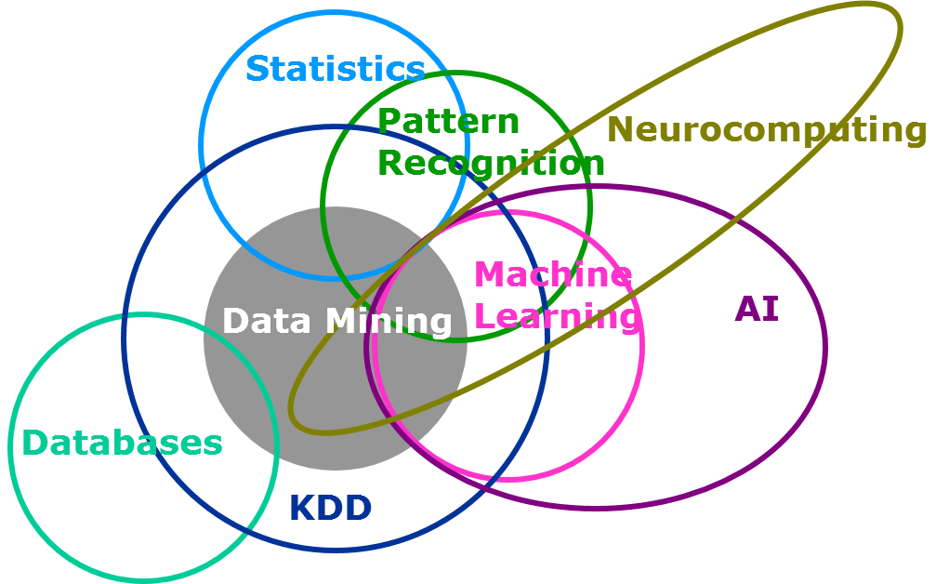
Computational Science
Source: blogs.sas.com
Notes:
Stat:参数估计，对假设检验，评估模型的效果

Slide 17







检查自身装备
Notes:
sql linear algebra

Slide 18





检查自身装备
Notes:
Cost — which both
developers and
procurement
specialists tend to
pick when presented with a listof potential hindrances to
undertaking any project — is less of a perceived problem now than
ever before. When given an opportunity to choose low cost as a
factor that would help purchaserschoose a Big Data product or
vendor over its competition, only 16% of developers cited cost.
Nearly 27% said the vendors participation in an open platform is far
more beneficial.

Slide 19
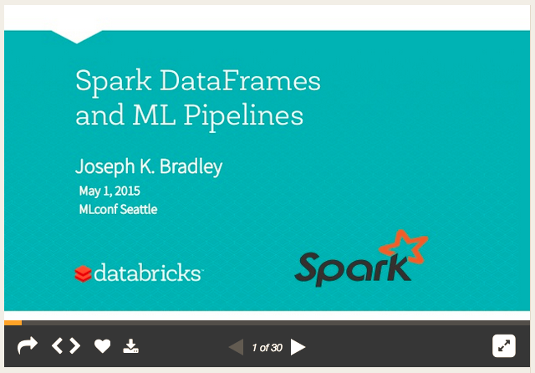
ML Pipeline
Scikit-learn style pipelines

Slide 20
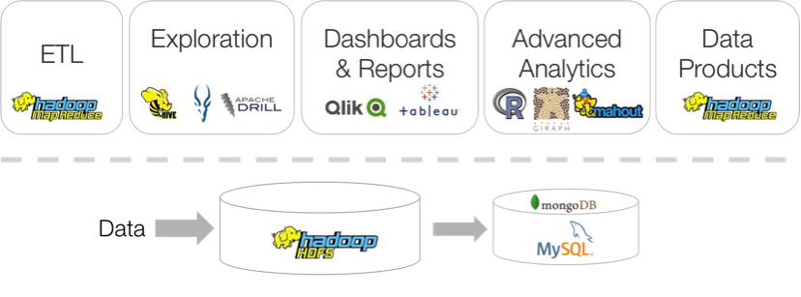
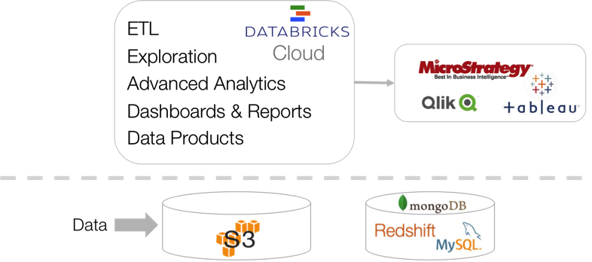
拥抱云的世界

Slide 21
all models are wrong, but some are useful
刺猬（一招鲜吃遍天） vs. 狐狸（一把钥匙开一把锁）
模型的复杂度与问题匹配：奥卡姆剃刀原理
如何做到数据越多、边际收益越大？
数据不可名状的功效：简单模型+大数据 > 复杂模型+小数据 ?
Ensemble
混合模型
Non-parametric vs. Parametric
Linear vs. Non-Linear
Discriminative vs. Generative
感知长尾信号 Exponential assumption vs. long tail
PCA/LDA/pLSA vs. 分级训练、模型组合、概率图模型、深度神经网络
Notes:
华人李祥林（David X. Li）开创的一个用以评估违约相关性的公式

Slide 22
Velocity
Interactive query
流计算
如时空数据
在线/流式/增量学习
增量训练，模型异步更新，快速部署
当又大又快时，你必须懂系统
Big Learning System：并行化/分布式化，系统调优
Notes:
数据并行，模型并行，任务并行，考虑一致性，损失精度从而加大并行度，靠更多的数据把精度补回来，但收敛变慢
cache random disk sequential
GC

Slide 23
Deep Learning
从语音识别，到图像理解，到自然语言理解
领域特化：如医学图像分析
进军“非认知”任务
搜索，广告，推荐，… …，visuo-motor skills, drug discovery
Automated laboratory
Open Source → Collaborative Open Computer Science
Pylearn2, Theano, Caffe
GitXiv = arXiv + Github + Links + Discussion
Notes:
深度学习将全面占领计算机视觉和语音识别领域；3）向量化表示的提出将对NLP领域产生重大影响，并将对机器翻译、网页搜索和对话系统等性能提升有所帮助

Slide 24
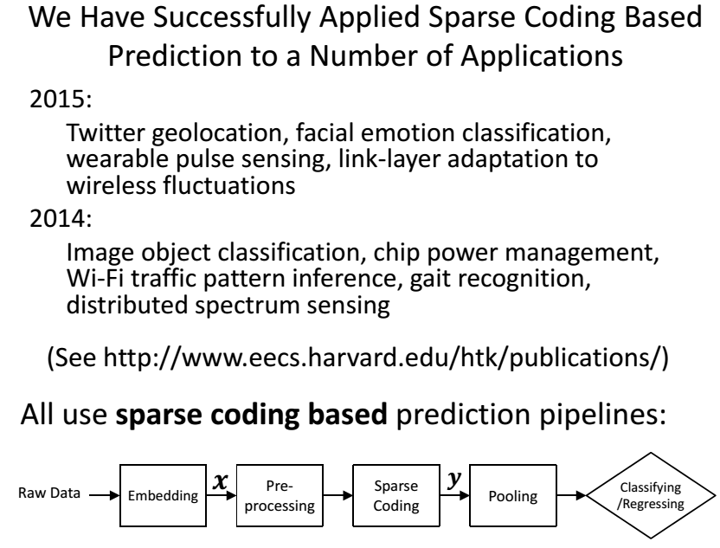
Sparse Coding
A strong tool to deal with low SNR and poor veracity
Source: HT Kung

Slide 25
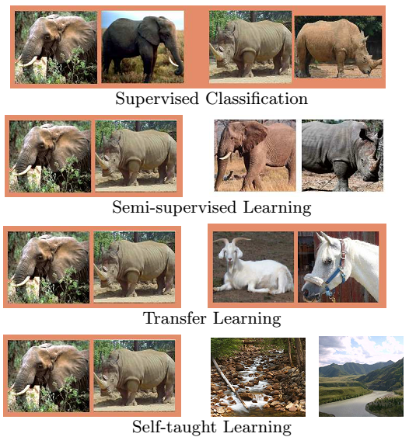
缺乏标注数据下的学习
Source: Andrew Ng

Slide 26
人的角色 Human Machine Intelligence
人的工作不断被取代
特征工程
比如以MLBase和VizDeck为代表的自动化分析和可视化
人与机器搭配获得最佳性能
比如Exploratory analytics/visualization
大规模人人、人机协作分析
外包Kaggle，众包CrowdDB，协作DataHub, 人类计算Duolingo

Slide 27
数据分析方法论的升级
Hypotheses
Collection
Preparation
Analytics
Interpretation
Evaluation
Notes:
Strategy is a logical argument for the creation and capture of value.
All arguments, and hence all strategies, rest on assumptions.
Strategy is an iterative process of testing and revising your argument as your assumptions play out in the market.

Slide 28
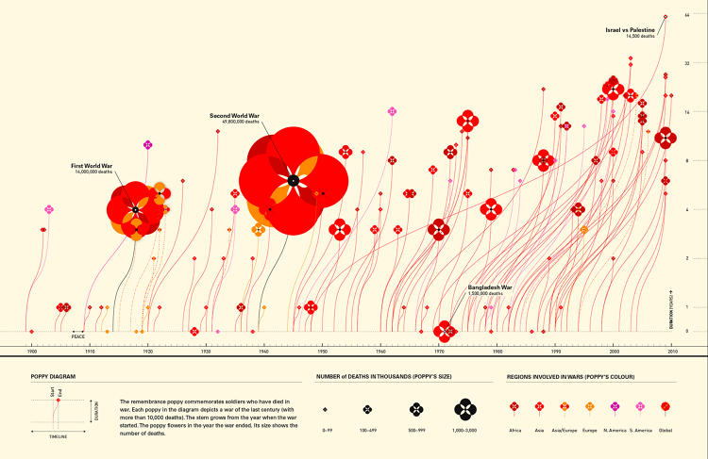
STEM → STEAM

Slide 29




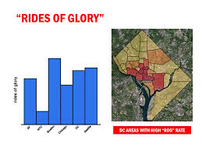
Story telling and “ideas worth spreading”

Slide 30
Documented
Use Cases
Hypotheses
Simulation
Collection
Preparation
Analytics
Interpretation
Evaluation

Slide 31
基础设施已经改朝换代 分析师也需要与时俱进
改变思维方式
提高技术素养
丰富分析能力

Slide 32
敬谢聆听

